Slide 1
#73 Gamification-based education platform
for sustainable agricultural and environmental applications
David Huang & Jesse Zeng
David Huang & Jesse Zeng
Notes:
Good morning, my name is Jesse and this is my partner David.
We are doing project #73 which is about developing a
gamification based education platform for sustainable agricultural and environmental applications.

Slide 2
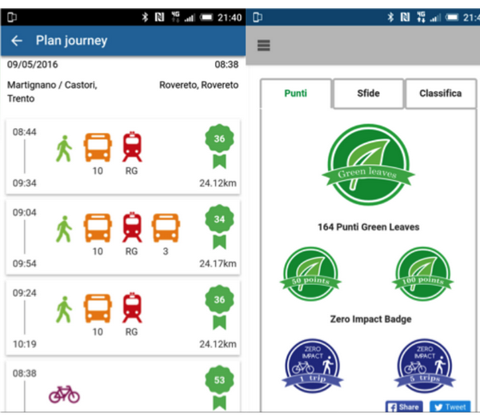
Gamification
“The use of game design elements in non-gaming contexts.” ¹
e.g. Points accumulation for using public transport
Project Focus
Spreading awareness and empowering people on an individual level
R. Kazhamiakin, A. Marconi, A. Martinelli, M. Pistore and G. Valetto, "A gamification framework for the long-term engagement of smart citizens", 2016 IEEE International Smart Cities Conference (ISC2), 2016.
[1] S. Deterding, R. Khaled, L. Nacke and D. Dixon, "Gamification: Toward a definition", 2011.
Notes:
We will be using gamification technology for our project. Gamification is the use of game design elements in non-gaming contexts. It entices people to do tasks or actions they otherwise may not do. An example of this is through rewarding users with points for using public transport instead of driving their car.
In this project we are investigating use of gamification to pass knowledge on sustainable agriculture. We are focusing on empowering individuals to make a change. During our research we found that there are attributes that define a successful gamification.

Slide 3
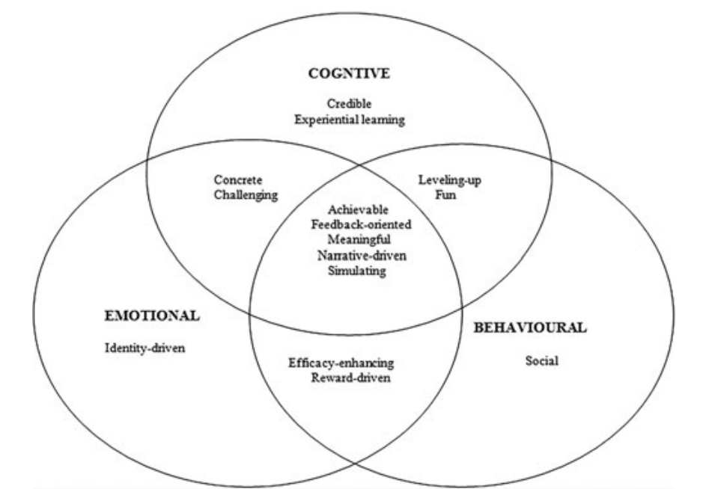
Games Framework
T. Ouariachi, M. Olvera-Lobo, J. Gutiérrez-Pérez and E. Maibach, "A framework for climate change engagement through video games", Environmental Education Research, vol. 25, no. 5, pp. 701-716, 2018.
Notes:
We discovered a gamification framework that proposed elements of successful user engagement in educational games. The games framework splits a number of attributes into 3 types of engagement.
Cognitive engagement relates to the learning aspects of the game such as knowledge and method of learning.
Emotional engagement relates to the problem the at hand and how the player can connect with the game.
Lastly, behavioural engagement relates to encouraging behavioural change through empowerment or social pressure from others.
We chose some of some of these attributes as a base for our literature review analysis and later on for evaluation of our project.

Slide 4
Applying the Gamification Framework
Credible knowledge
Experiential learning
Simulating
Rewards driven
Social Interaction
Icons - FlatIcon
Notes:
These are the 5 key attributes we chose for this project.
Firstly, credible knowledge should be presented to the user for accurate learning.
And users should be able to learn the learning outcomes through their own experience and experimentation.
For simulating, the design should allow users to simulate actions that they cannot do in real life, as simulation will relate actions to consequences to enforce learning
Reward driven is an important factor to motivate the user and increase participation.
And lastly social interaction is good for user validation and peer pressure which relates to behavioural engagement.
We have used these attributes in our literature review.

Slide 5
Literature Review Analysis
Points Collection Application
Points reward system to encourage sustainable actions
Contains
Reward driven
Social Interaction
Missing
Experiential learning
Simulation
Adapting to real world variables
Simulation Game
Educate and introduce players to farming in a virtual environment
Contains
Reward driven
Credible Knowledge
Experiential learning
Missing
Social interaction
Realism
Notes:
Our literature review analysis uncovered two common designs of gamification. The first design is a points accumulation app which reward points to users for choosing sustainable alternatives. However these points apps lacks experiential learning since it does not prioritise education but rather encourages more sustainable behaviours.
The second design is a simulation game. These games create a virtual environment representing reality that allows users to experience things they may not in real life. There are the Credible knowledge and Experiential learning attributes since players need to learn through trial and error. However, the simulation games reviewed had no social interaction due to a single player experience.
We also noticed that realism was a common missing factor. The points app does not account for real world variables for example it encourage users to bike even in bad weather conditions. And the simulation game lacks realism as it only deals with the virtual space. These factors leads to our research intent and objectives.

Slide 6
Research Objectives
Gamification tool for education
Use gamification to inform users about sustainable agricultural practices
01
Knowledge
Realism
Create realistic learning environment
Present concepts with a definite link to reality
02
03
Behaviour
Include transferable sustainability practices such as saving water
Notes:
Our first project objective is to spread knowledge about sustainable agricultural applications using gamification as a tool. We want to introduce users to sustainable agriculture and apply this knowledge in a virtual setting.
The second project objective is crafting a realistic learning environment. The user should be able to interact with our tool and experience doing real life tasks in a virtual environment.
Lastly our third objective is to have an impact on players behaviours and thoughts about sustainability. For example, through playing our game we hope that players can action the idea of using less water in their daily lives.

Slide 7
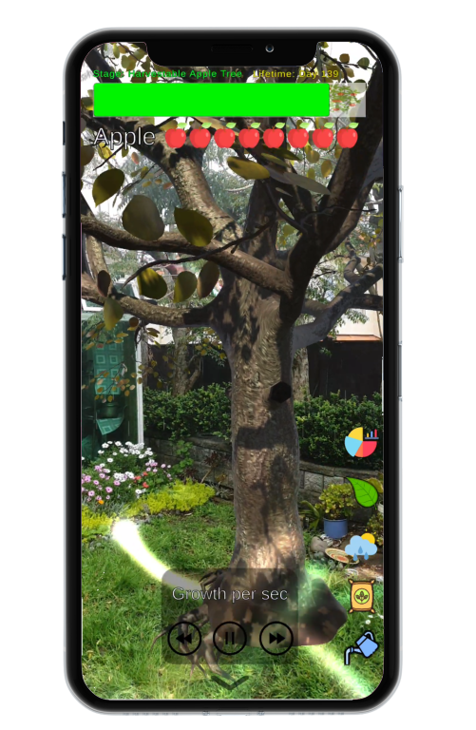
Research Intent
Augmented Reality (AR) Based Game for Sustainable Agriculture
Notes:
Our research intent was to use augmented reality technology to create an interactive and realistic virtual learning environment.
We chose to use AR because AR provides a connection between the virtual world and the physical space using the camera.
In this app, users will learn how to grow a virtual apple tree and care for it throughout its lifetime.
The user will need to complete virtual actions, including watering and fertilising, to care for the apple tree.

Slide 8
Technical
Stack
Unity - Game development software
AR foundation
AR core
C#
Implementation for Android devices
Icon - FlatIcon
Notes:
To create the AR game application, we have used the game development tool Unity. Unity has extensive support and features for developing AR applications, including for model building and environment sensing.
Our app is focused on developing for Android devices because we used our personal Android devices to test our prototypes.
Now I will pass on to David who will begin with the virtual apple tree implementation.

Slide 9
Apple tree’s growth cycle
Research
User should fertilise every year
Because of growth cycle from 7 year to 100 days, player need to fertilise every 14 days
Research
6 stages of growth
Total growth cycle: 7 years
Growth cycle changes
Total growth cycle: 100 days
Notes:
To implement this, the growth system of the tree must be created.
Through the initial research, there are 6 stages of growth where it will take around 7 years for the tree to be fully harvestable.
However, since this is a game, it will be not be feasible for the user to play the game for 7 years. As a compromise, we changed the growth cycle from 7 years to 100 days.
100 days was chosen because it has substantially shorter length of time, although still long enough for a user to explore the different stages of an apple tree.

Slide 10
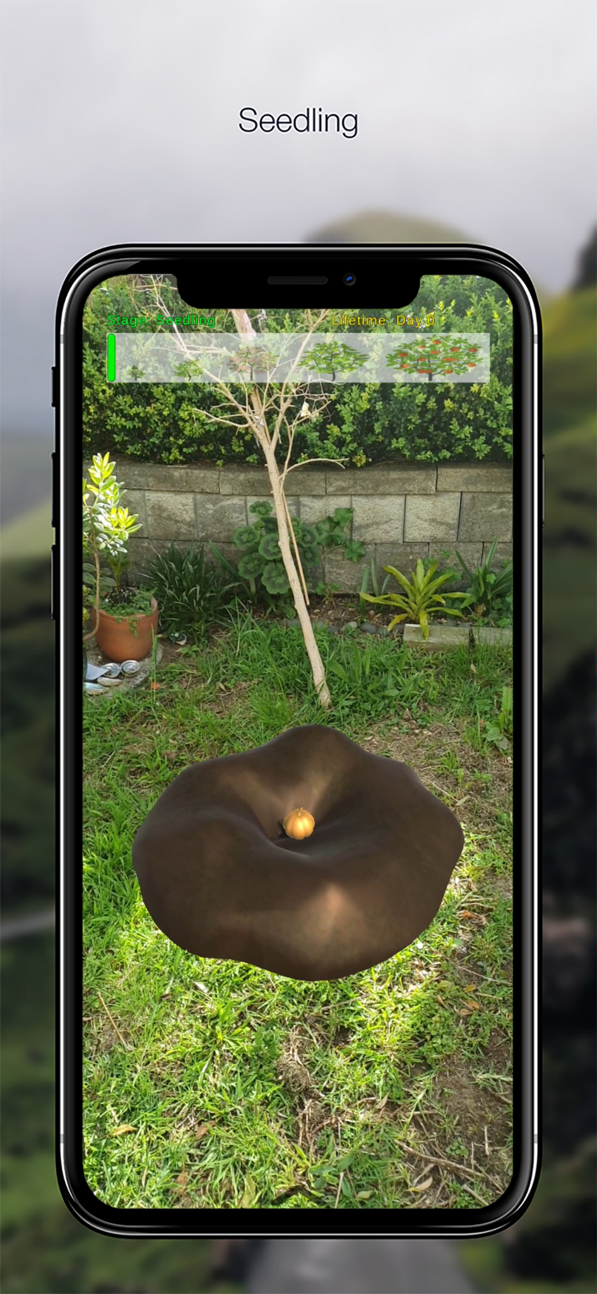
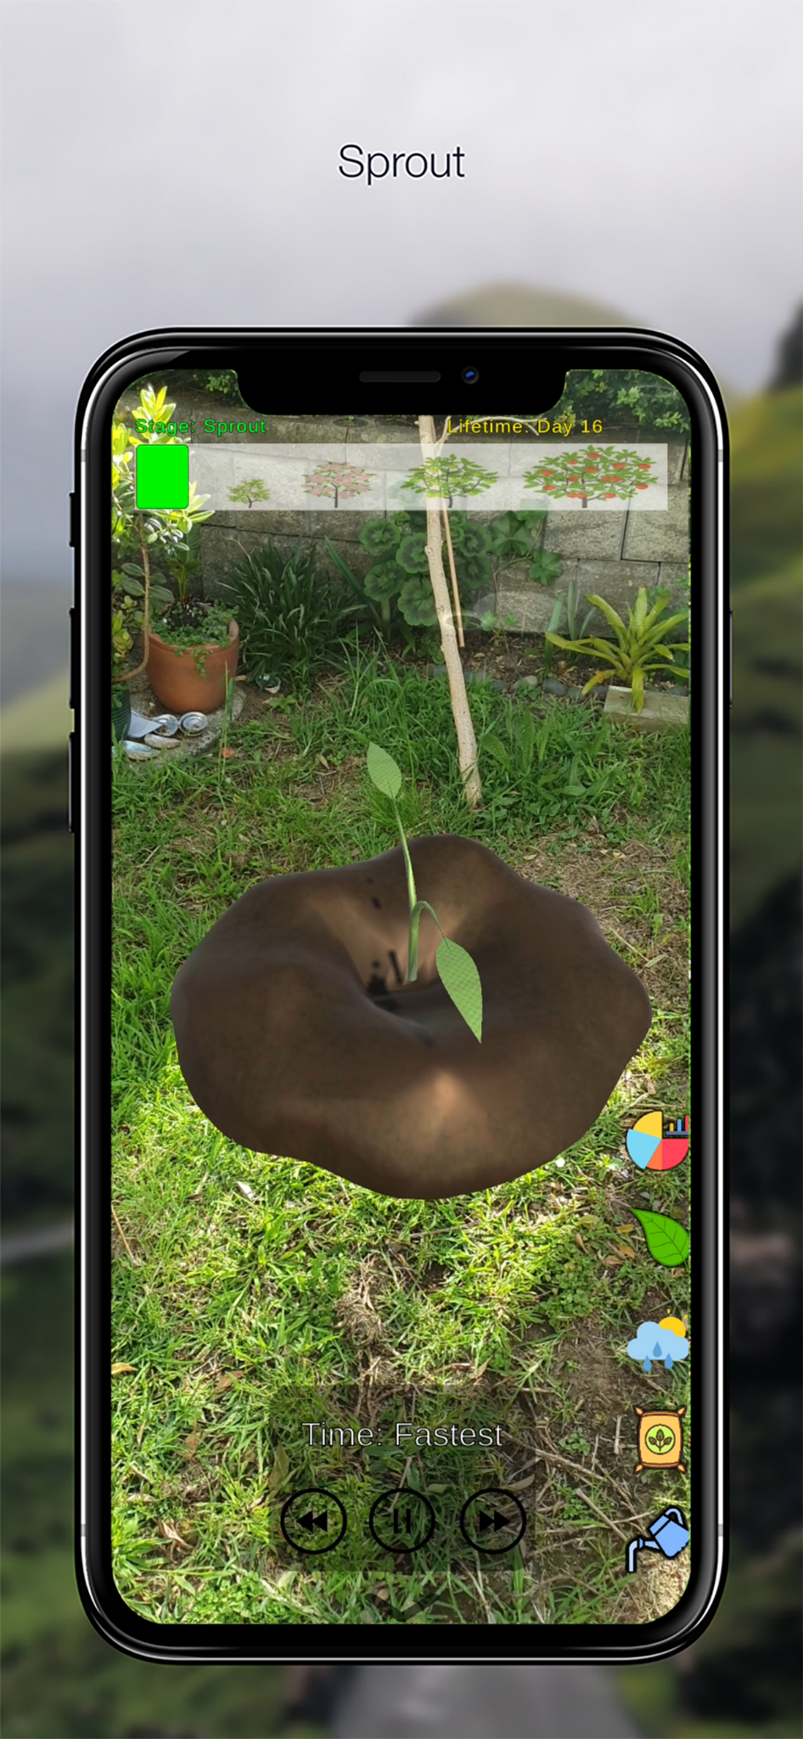
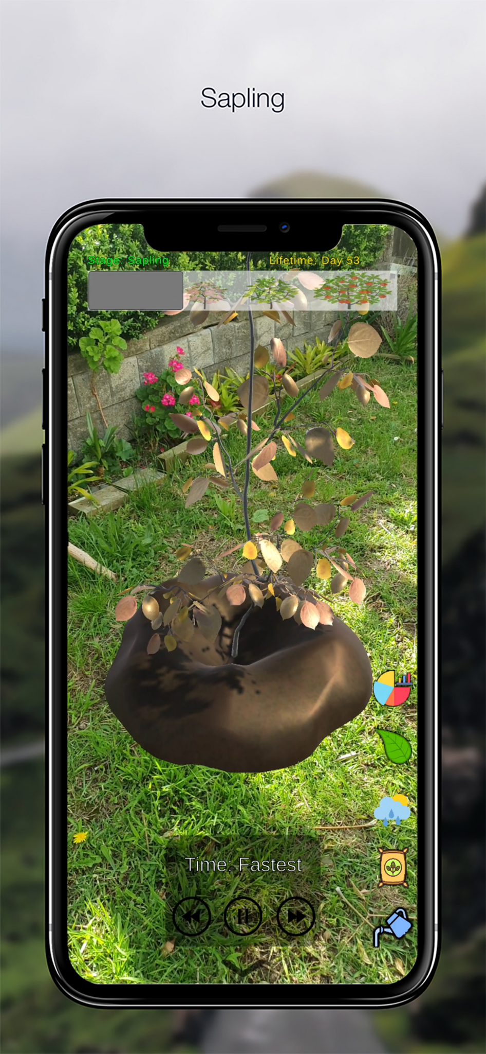
Early life Cycle (stage 1 - 3)
Notes:
To begin, during the early life cycle of the tree, there are three stages.
The first stage is the seedling, the second is the sprout, and finally, the third is a sapling.
These stages requires less time compared to next life cycle.

Slide 11
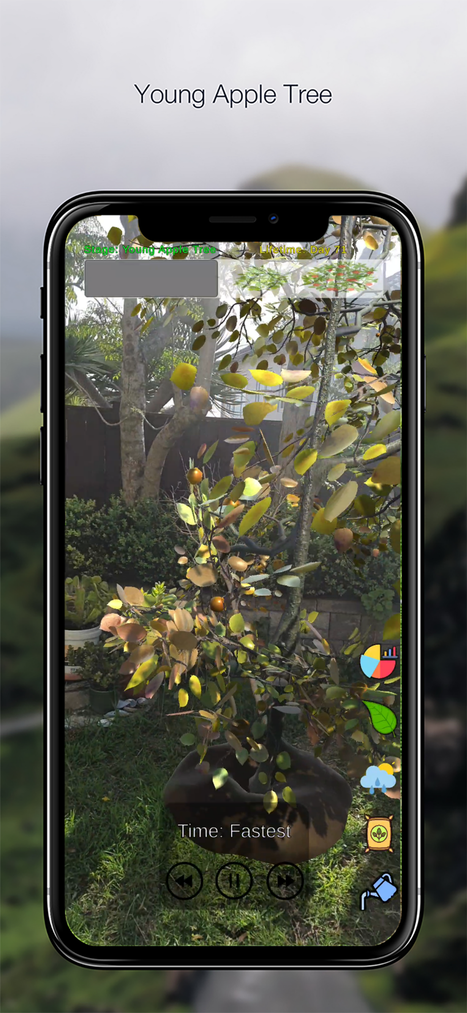
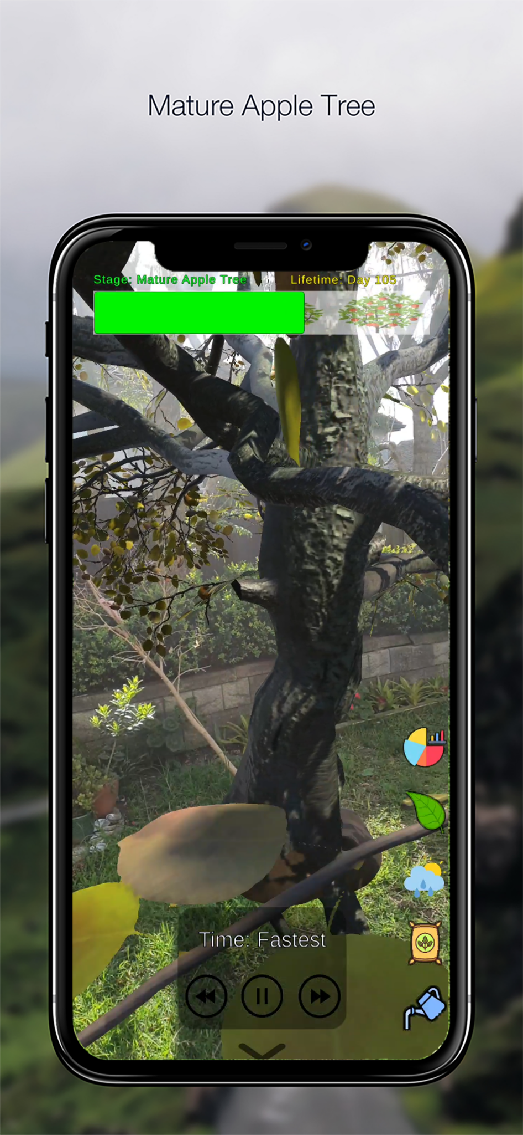
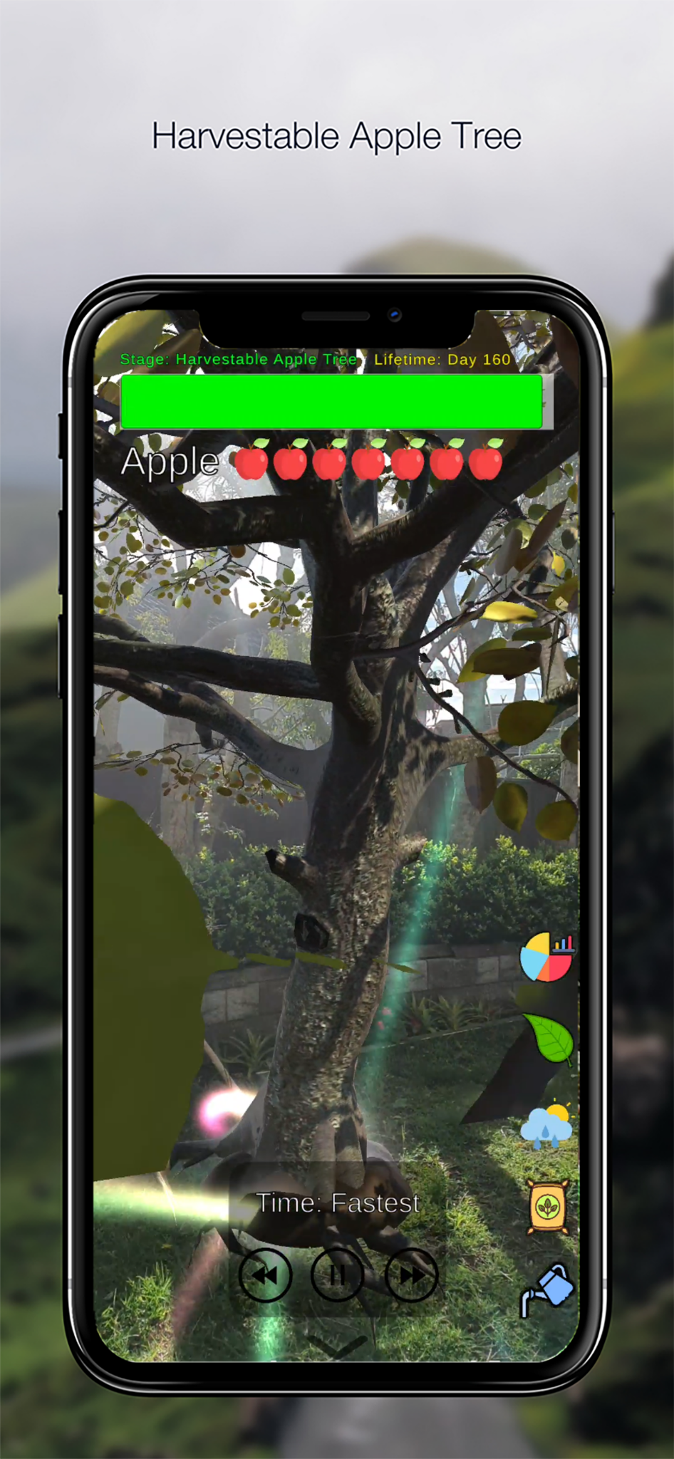
Late life Cycle (stage 4 - 6)
Notes:
During the late life cycle of the apple tree,
there are the young apple tree, the mature tree, and finally, the harvestable apple tree.

Slide 12


Player Actions
Fertilisation
Fertilise the tree once every year
Due to the growth cycle change from 7 year to 100 days
Player need to fertilise every 14 days
Irrigation
Water the tree once every 7 to 10 days, assuming no rainfall
Rainfall affects how often the player should water the apple tree
Notes:
The two main actions that influence the virtual apple tree's progression, are irrigation and fertilisation.
These core actions were chosen as water and nutrients directly affect the growth of an apple tree.
From initial research, the tree should be fertilised once every year.
However, due to the growth cycle change from 7 years to 100 days, players in the game will only need to fertilise every 14 days instead.
For irrigation, the apple tree should watered every 7-10 days, assuming there are no rainfall to increase soil moisture levels.

Slide 13
Weather System
IoT Data
Data gathered from Ohinewai, New Zealand
Weather data
Temperature (°C)
Rainfall (mm)
Impact on System
Warmer temperatures (> 20°C) increases the rate of water decrease in the soil
Rainfall reduces the rate of water decrease in the soil
25mm of rainfall in the past week is sufficient water
Notes:
Rain and temperature is chosen to be part of the weather system in the application. These IoT data is gathered from a real life farm in NZ to better resemble the natural environment for apple tree cultivation.
These two factors impact water levels as rainfall increases soil moisture, while temperature decrease water levels, through evaporation.
As for Nutrients, they are not impacted by the weather.
Due to the weather system in the game, the player must adapt by watering the tree according to the current weather conditions.

Slide 14
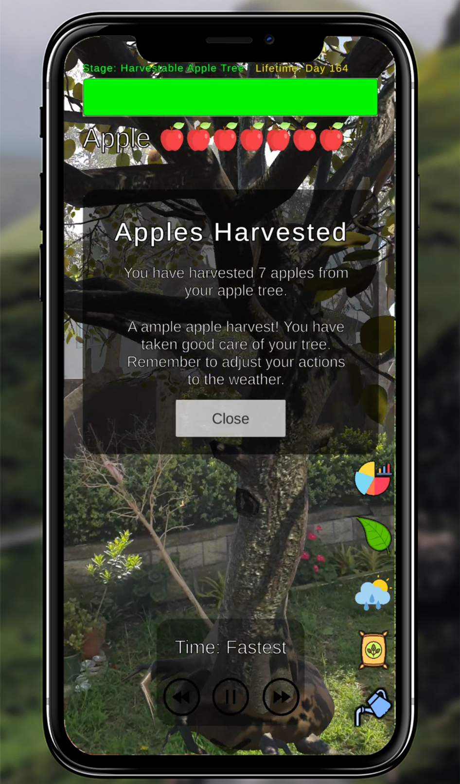
Apple Harvest System
Player starts with 8 apples
Lose an apple per bad player action
Players can improve their cultivations skills further, even after reaching the last growth stage
Notes:
If the player has taken good care of the tree by watering and fertilizing the plant correctly and is able to reach the end of the growth cycle.
The player will be rewarded with apples. The number of apples rewarded will depend on the player’s performance.
In the beginning of the game, the player starts with 8 apples. The total number of apples will decrease by 1, each time the player has not taken good care of the apple tree.
When the apples are harvested, players can view the feedback on how well they cared for the tree and tips on how to improve.

Slide 15
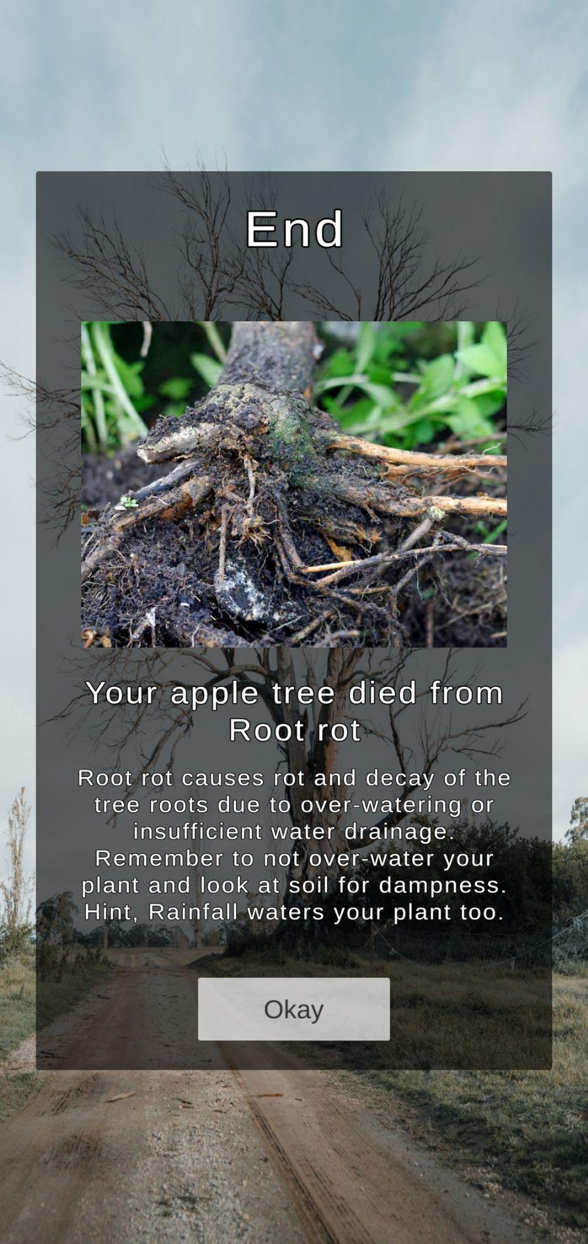
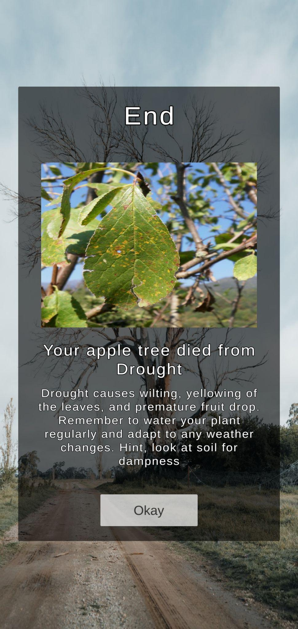
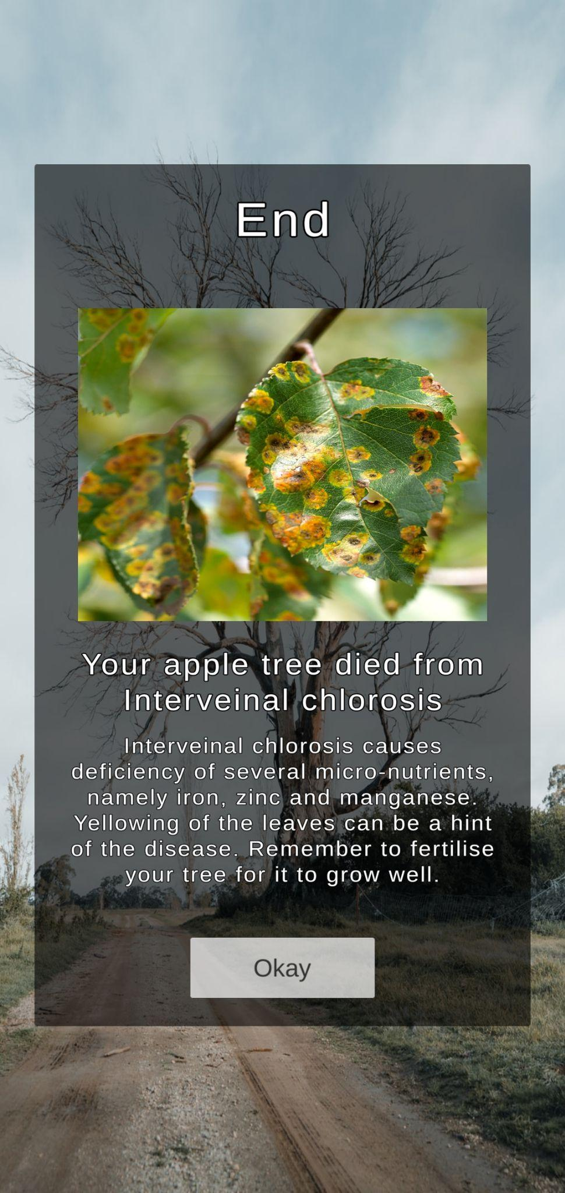
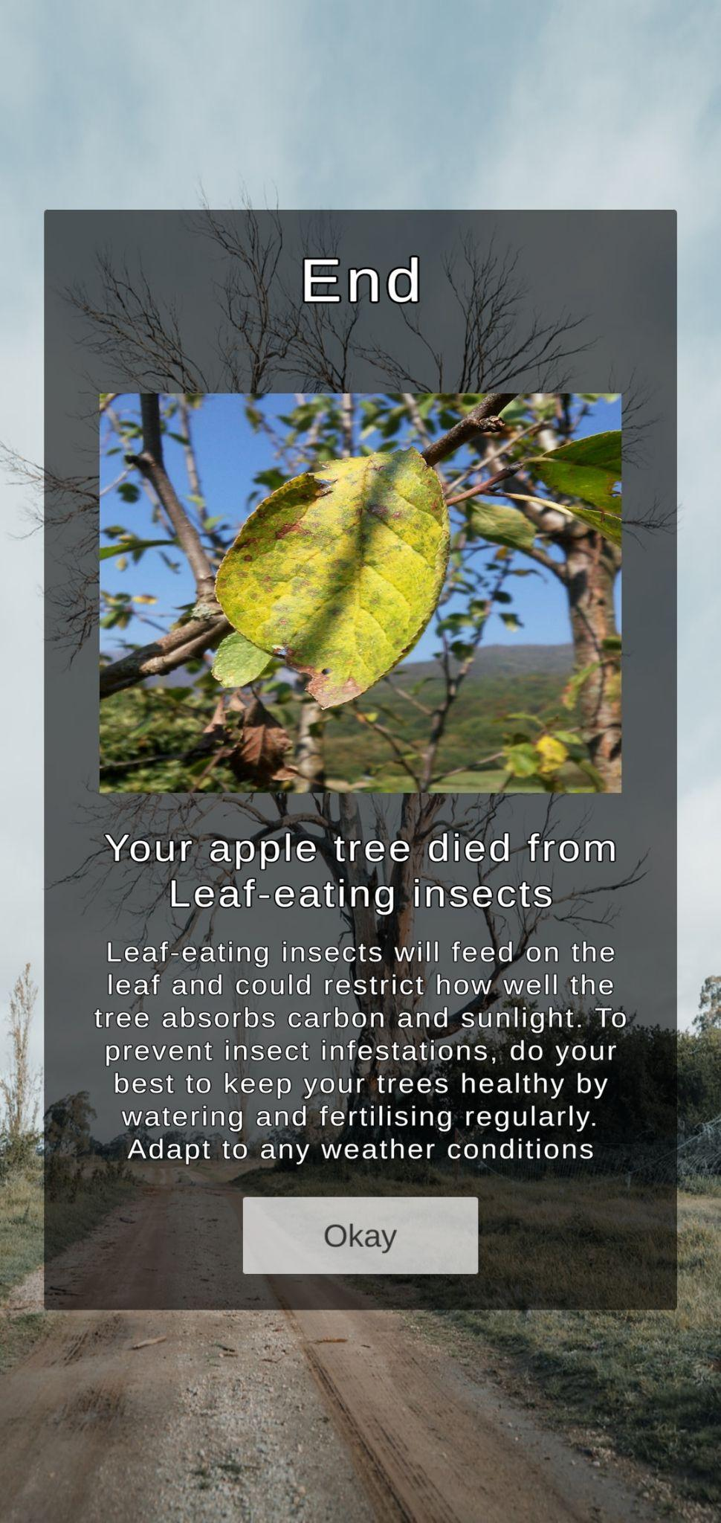
Apple Tree Conditions
Notes:
However, if the player has not taken good care of the apple tree, due to excess player actions or inaction. The tree will reach its end.
For example, one of the death conditions is Root rot where the player has over watered the tree for too long.
The player is shown the reason on why the tree has died and there is feedback on how to improve for their next playthrough.
These consequences will ideally teach the player to be more sustainable towards using water or nutrients to sustain their apple tree’s health.
The next three death conditions are caused by insufficient levels of nutrients or water levels.

Slide 16
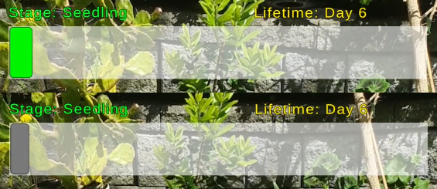
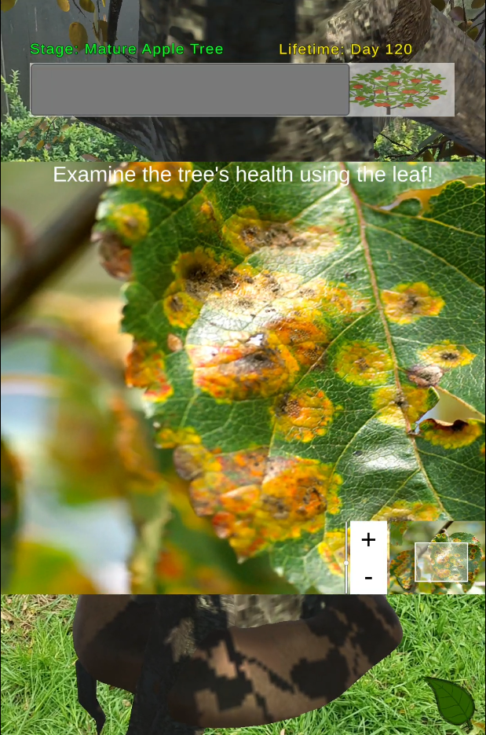
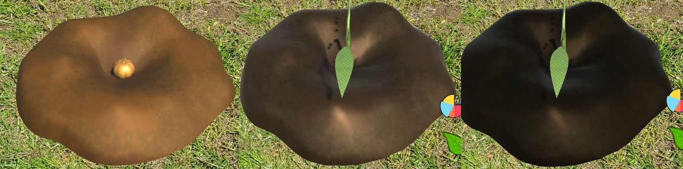
Game indicators
Notes:
Fortunately, there are game indicators to show the current health status of the apple tree.
For example, in the top image, the progress bar will turn green if the growth rate is optimal and turn grey if not.
For the AR model of the soil, the color will darken as water levels increase in the ground.
Furthermore, the image on the right is a panel for users to inspect the tree's health by analysing the 2D image of a leaf.
For example, there's some yellowing on the leaf. This means there's a lack of nutrients in the tree; therefore, the tree requires fertilisation from the user.

Slide 17
Evaluation
Watering the tree is based on agricultural knowledge and rainfall impacts
Accuracy of fertilisation system compromised for game design
Credible knowledge
Player learns by growing the apple tree through the full life cycle
Results and feedback on how to improve are shown at the end
Experiential learning
Notes:
To evaluate our application, we have used the games framework attributes as mentioned earlier.
For credible knowledge, the concepts presented in our design are based on actual agricultural knowledge which are factual.
However for the fertilisation, the accuracy of the system was compromised for an engaging game design.
Otherwise the player would never need to do this action in the short life cycle of the tree.
For experiential learning, players learn through experimenting and seeing the consequences of their actions throughout the tree’s life cycle.
Additionally, the application has a feedback system to help the player improve and enforce learning outcomes.

Slide 18
Evaluation
AR allows the user to see a realistic representation of the apple tree
The models and environment change depending on the state of the tree
Simulating
Player feel rewarded when reaching the next growth stage
Player is rewarded with harvesting apples at the end of the final stage
Rewards driven
Notes:
For simulating, using AR to virtually plant, can simulate the experience of growing a real apple tree without any physical constraints.
The 3D model of the tree also change depending on the current growth stage, much like a real apple tree.
When these models change, we believe it is a rewarding experience for the player as it motivates their progress.
As the player progresses and reaches to the end of the tree’s life cycle, they can harvest apples based on their overall performance and care for the tree.

Slide 19
Conclusions
Research Objectives
01
Knowledge
Apple tree death due to consequences of actions
Data (e.g graphs) to give players an informed decision
02
Realism
Semi-realistic apple tree models in AR
Linked weather data (rain and temperature) with apple tree growth
03
Behaviour
We intend to measure our behaviour research objective results through a user survey in the future.
Notes:
In conclusion, we have met the key objectives of knowledge and realism.
The player gains knowledge through the feedback given to them as they go through a series of trial and error.
For realism, the player feels like they are in a realistic learning environment due to semi-realistic AR models and realistic weather conditions that are sourced from a real life farm.
However, for the key objective of behaviour, we intend to measure this through user survey in the future to measure the impact and effectiveness of our implementation.

Slide 20
Future Directions
-> User Study
01
02
03
04
Expand Knowledge
Add More Player Actions
Expand Weather Data
Static Location for the Tree
Teach users more about sustainable agriculture
Over-fertilising
Overuse of pesticides
Preventing and managing apple tree diseases sustainably
Pruning
Pest control
Include more IoT data to model the real environment
Wind
Humidity
Sunshine hours
Use GPS location data to plant the virtual tree on real soil
Use location accurate weather data
Notes:
For the future direction of our research, we have identified 4 key ideas.
The first idea is to broaden the knowledge we share in our app to teach more about sustainable agriculture. For example, we want to share that fertilising too much can pollute the environment and waterways.
The second idea is to add more actions that the player can do. Actions such as pruning and pest control in a sustainable way so that this knowledge can be applied to a real apple tree.
The third idea is to expand the weather data used in our app. Wind, humidity and sunshine hours could be added for a more comprehensive model of an apple tree’s growth.
Our fourth idea is to make a permanent location option for the virtual tree. For example, the apple tree could be set to a GPS location in your garden or anywhere in the world.
We think this would make the planting more realistic. This could also link to a social feature where you could see other players’ trees.

Slide 21
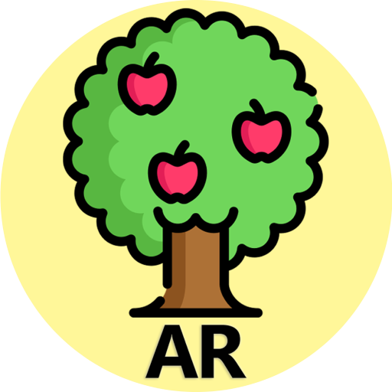
Demo
Notes:
Next we will move on to our application demo.

